Slide 1
Office Supplies Sales Data set
Scope
This data set includes sales orders raised by the representatives categorized according to region, item, order quantity ,unit price between Jul 2014 to May 2015. The purpose of the analysis is to draw conclusions on sales history & suggest valuable insight (Considering Sales of office supplies to be dependent on number of orders, order quantity & Sales Value ideally)

Slide 2
Dataset analysis
Qualitative Analysis
No of Orders (Year, Month, Region, Representative)
QuantitativeAnalysis
No of Units
Unit Price
Value (Sales Order Price)

Slide 3
No of Orders Vs Year, Month, Region
SINGLE VARIATE
COMPARISON
Year | No of Orders
2014 | 22
2015 | 21
No of Orders
Region | 2014 | 2015
Central | 11 | 13
East | 8 | 5
West | 3 | 3
Total | 22 | 21
Year | Month | No of Orders
2014 | Jul | 4
 | Aug | 3
 | Sept | 4
 | Oct | 4
 | Nov | 3
 | Dec | 4
2015 | Jan | 3
 | Feb | 4
 | Mar | 3
 | Apr | 4
 | May | 4
 | Jun | 3
% Order Contribution
Region | 2014 | 2015 | Fluctuations
Central | 50 | 62 | 12% Increase
East | 36 | 24 | 12% Decrease
West | 14 | 14 | No Change
Total | 100 | 100

Slide 4
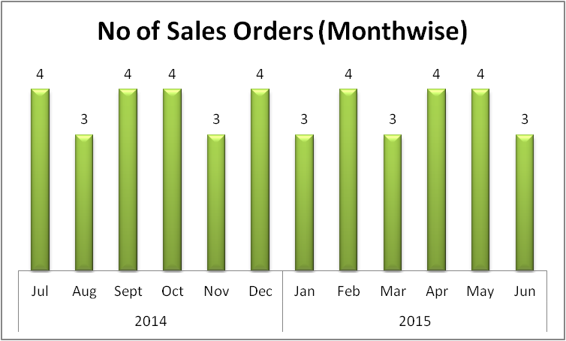
No of Orders Vs Year, Month, Region
Inference :
Central Region bags many number of orders and
contributes more to sales by increasing customer
Orders over a period of time

Slide 5
No of Orders Vs Year, Region, Representative
No of Orders
Representative | 2014 | 2015 | Region | Positive Increase
Alex | 2 | 3 | Central | 1
Bill | 1 | 4 | Central | 3
Matthew | 2 | 2 | Central | 0
Morgan | 2 | 1 | Central | -1
Smith | 2 | 1 | Central | -1
Rachel | 2 | 2 | Central | 0
Nick | 1 | 1 | East | 0
Richard | 4 | 4 | East | 0
Susan | 3 |  | East | -3
Thomas | 1 | 1 | West | 0
James | 2 | 2 | West | 0
Inference :
Alex & Bill show improvement
in the number of sales order
captured in the central region

Slide 6
No of Orders Vs Year, Region, Item
No of Orders |  |  |  | Region
Item | 2014 | 2015 | Fluctuations | 2014 | 2015 | Fluctuations
Pen | 3 | 2 | -1 | West-1, East-2 | East-1,Central-1 | Decrease
Pen set | 6 | 1 | -5 | Central-3,East-3 | Central-1 | Decrease
Pencil | 4 | 9 | 5 | Central-3,East-1 | Central-6,West-2,East-1 | Increase
Binder | 7 | 8 | 1 | Central-4, East-2,West-1 | Central-4, East-3,West-1 | Increase
Desk | 2 | 1 | -1 | Central-1,West-1 | Central-1 | Decrease
Total | 22 | 21
Inference :
There is an increase in sales order of pencil & binder from 2014 to 2015

Slide 7
Representatives Vs Year, Region
Manpower
Representative | Region | 2014 | 2015 | 2014 | 2015
 |  | No of Representatives |  | % Manpower
Alex | Central | 6 | 6 | 55 | 60
Bill
Matthew
Morgan
Smith
Rachel
Nick | East | 3 | 2 | 27 | 20
Richard
Susan |  |  | 0
Thomas | West | 2 | 2 | 18 | 20
James
 |  | 11 | 10 | 100 | 100
Inference :
11 Sales representatives served from Jul-Dec 2014
Susan sales data missing / susan left the job during Jan-Jun 2015
10 Sales representatives served from Jan-Jun 2015
More Sales representatives are employed in Central region

Slide 8
Unit Price Vs Region,item, representative
Region | Rep | Item | No of Units | Unit Price
East | Nick | Binder | 29 | 1.99
Central | Alex | Binder | 11 | 4.99
Central | Rachel | Binder | 28 | 4.99
East | Richard | Binder | 4 | 4.99
East | Richard | Binder | 60 | 4.99
Central | Morgan | Binder | 28 | 8.99
Central | Bill | Binder | 46 | 8.99
Central | Bill | Binder | 80 | 8.99
East | Richard | Binder | 60 | 8.99
Central | Smith | Binder | 87 | 15
Central | Alex | Binder | 94 | 19.99
Central | Matthew | Binder | 50 | 19.99
East | Susan | Binder | 81 | 19.99
West | Thomas | Binder | 57 | 19.99
West | James | Binder | 7 | 19.99
Inference : The Items are priced dynamically. Fixed Price method is not followed here. Though Sales Value is driven by number of customer orders, it is primarily impacted by number of units & unit price only

Slide 9
Unit Price Vs Region, item, representative
Inference:
There is huge difference in pricing of items across different regions & representatives due to Dynamic pricing
Binder | No of Orders |  | No of Units sold |  | Sales Value of Order
Representatives | 2014 | 2015 | 2014 | 2015 | 2014 | 2015
Alex | 2 |  | 105 |  | 471
Bill |  | 2 |  | 126 |  | 319
James |  | 1 |  | 7 |  | 140
Matthew |  | 1 |  | 50 |  | 719
Morgan | 1 |  | 28 |  | 140
Nick | 1 |  | 29 |  | 539
Rachel | 1 |  | 28 |  | 55
Richard |  | 3 |  | 124 |  | 4184
Susan | 1 |  | 81 |  | 1619
Thomas | 1 |  | 57 |  | 1139
Smith |  | 1 |  | 87 |  | 252
Total | 7 | 8 | 328 | 394 | 3964 | 5614
 | 15 |  |  | 722 |  | 9578

Slide 10
Sales Value Vs Year, Region,item, representative
Year | Total Sales Value** | % Total Sales for one accounting period
2014 | 11452 | 58
2015 | 8176 | 42
Total | 19628 | 100
Representative | Total Sales Value | % Sales Contribution
Alex | 2812 | 14
Matthew | 3109 | 16
Richard | 2363 | 12
Susan | 3102 | 16
Bill | 1750 | 9
Smith | 1641 | 8
Morgan | 1388 | 7
James | 1284 | 7
Thomas | 1203 | 6
Nick | 537 | 3
Rachel | 438 | 2
Total | 19628 | 100
Region | Total Sales Value | % Sales Contribution
Central | 11139 | 57
East | 6002 | 31
West | 2487 | 13
Total | 19628 | 100
Item | Total Sales Value | % Contribution
Binder | 9577.65 | 49
Pencil | 2135.14 | 11
Desk | 1700 | 9
Pen | 2045.22 | 10
Penset | 4170 | 21
Total Sales Value | 19628 | 100
**Total Sales value is calculated for one accounting period
(Jul 2014-Jun2015)

Slide 11
Sales Value Vs Region, item, representative
Inference :
Among the sales representatives, Matthew ‘s contribution to sales is the highest during the accounting period (2014-2015)
Among the items, maximum contribution to sales value is provided by Binder
Also Central region holds the maximum sales value generated

